Slide 1


Introduction to R and RGUI for Running DEGTrend
Michelle Kojekine
Dr. Asaf Marco
16.02.2026

Slide 2
Workshop Goal
By the end of this session you will be able to:
Work confidently in RGUI
Control your working directory
Load data files correctly
Run scripts using source()
Install and load packages
Update R when needed
Tomorrow: DEGTrend.

Slide 3
What is R?
Programming language for statistics and data analysis
Widely used in bioinformatics
Command-based (not point-and-click)
Key idea:
R executes commands line by line.

Slide 4
R Interface (Windows vs Mac)
Windows:
RGUI
Mac:
R.app
Both include:
Console
Script editor
Graphics window
Core logic is identical.

Slide 5
The R Console
> means R is ready
Press Enter to execute
Errors appear immediately

Slide 6
Working Directory (Critical Concept)
The working directory is:
The folder where R looks for files
The folder where R saves output
If wrong → files cannot be found.

Slide 7
Working Directory Commands
Check current folder:
getwd()
Set (Windows example):
setwd("C:/Users/YourName/Desktop/R_workshop")
Set (Mac example):
setwd("~/Desktop/R_workshop")
List files:
list.files()
Golden rule:
Always check getwd() before running scripts.

Slide 8
File Paths (Windows vs Mac)
Windows:
C:/Users/Name/Desktop/file.csv
Mac:
/Users/name/Desktop/file.csv
Or:
~/Desktop/file.csv
Important:
Use / not \
Mac is case-sensitive
Avoid Hebrew characters in path
Avoid spaces and special characters

Slide 9
Common Path Errors
Windows error:
'\U' used without hex digits
→ You used \ instead of /
Mac error:
cannot open file
→ Check capitalization
Mac example:
File.csv ≠ file.csv

Slide 10
Why Use Scripts?
Typing commands manually is risky.
Scripts allow:
Reproducibility
Organization
Running full analyses
DEGTrend runs via script.

Slide 11
Running a Script
Save file as .R
Confirm working directory
Run:
source("script_name.R")
If there is an error → execution stops.

Slide 12
Graphics (Windows vs Mac)
Windows:
grDevices::windows()
plot(1:10)
Mac:
quartz()
plot(1:10)
In most cases:
plot(1:10)
works automatically.

Slide 13
What is a Package?
A package is:
A collection of functions
Extends base R functionality
Examples:
DESeq2
RUVSeq
Ggplot2
DEGTrend depends on packages.

Slide 14
Loading Packages
Installing ≠ Loading
Load every session:
library(ggplot2)
library(DESeq2)
If you see:
there is no package called ...
It is not installed.

Slide 15
Checking R Version
Check version:
  R.version.string
Or:
  sessionInfo()
Old R versions may cause package failures.

Slide 16
Updating R
R does NOT update automatically.
Windows:
Download from cran.r-project.org
Install latest version
Mac:
Download R for macOS
Install normally
Restart computer after installation.

Slide 17
Updating Packages
Check outdated packages:
  old.packages()
Update all:
  update.packages(ask = FALSE)
Update Bioconductor:
  BiocManager::install(update = TRUE, ask = FALSE)
Restart R after updating.

Slide 18
Mac-Specific Note (Important)
If Bioconductor package installation fails with:
clang error
Open Terminal and run:
xcode-select --install
This installs required developer tools.
Most Macs already have it.

Slide 19
Common Errors
Typical issues:
Wrong working directory
Wrong file path
Package not installed
Case sensitivity (Mac)
Most problems are environment-related.
Not programming-related.

Slide 20
Tomorrow: What You Need Before Starting
R installed on your computer (version 4.4 or higher).
  If you don’t have R: download it from https://cran.r-project.org/ (or https://cloud.r-project.org).
  Required R Packages Installation (as detailed in the git)
Your data files ready (DEG tables, count matrix, sample info, etc.).
  Example data for DEGTrend is available in the following Google Drive folder:
  https://drive.google.com/drive/folders/1HgtBbxDIWFP47Bp6M3hT0WvLkLlPJlVE?usp=sharing
A folder where you want all results to be saved (the program will ask you for this).

Slide 21
Required R Packages
install.packages("BiocManager")
install.packages(c("shiny", "ggVennDiagram", "plotly", "DT", "miniUI", "sf", "ggupset", "readxl", "ggplot2", "RColorBrewer", "circlize", "viridis", "reshape2", "openxlsx", "VennDiagram", "dplyr", "tidyr", "stringr", "matrixStats"), dependencies = TRUE)
BiocManager::install(c("DESeq2", "RUVSeq", "edgeR", "rtracklayer", "ComplexHeatmap", "Biobase", "SummarizedExperiment"), dependencies = TRUE, update = TRUE, ask = FALSE)

Slide 22
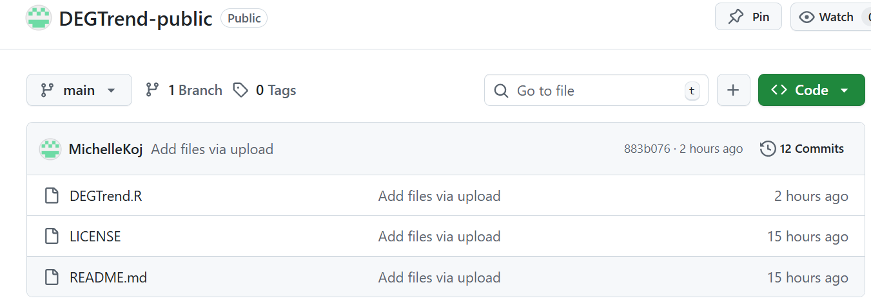
Downloading DEGTrend.R from GitHub
We will download only the main script file: https://github.com/MichelleKoj/DEGTrend-public

Slide 23
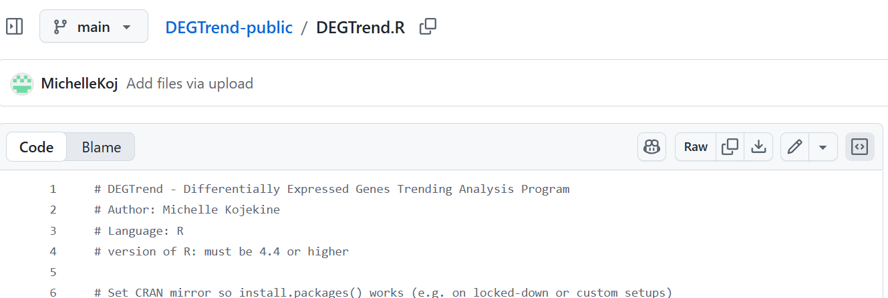
Save it inside your working folder
(for example):
Windows: C:/R_workshop/
Mac: ~/Desktop/R_workshop/

Slide 24
Run DEGTrend.R (for example):
setwd("<your full path> ")
source("DEGTrend.R")
Or:
source("<your full path>/DEGTrend.R")

